Slide 1
Easy Image file type converter
Presented by: Alex Thompson

Slide 2
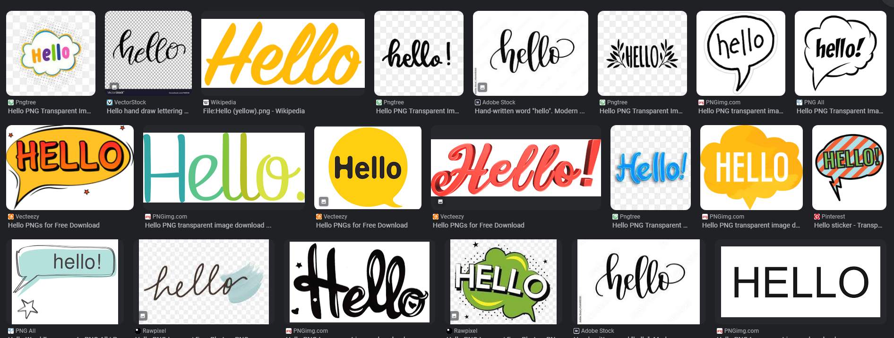
Purpose
Personal hobby uses images
Finding images online comes with issues of image file types
Not all websites and software accept all file types
Notes:
In my spare time, one of my favorite hobbies to do is edit media, whether that is video with Adobe’s Premiere Pro or photos with Adobe’s Photoshop.
During those processes, I use images a lot. Usually I would look up on Google to find images, and sometimes that is not the easiest task due to the file type of the images.
If I wanted to download an image with a transparent background, there is a good chance the image file type will be a WEBP.
The issue here is, the version of Adobe products I use do not accept this type.

Slide 3
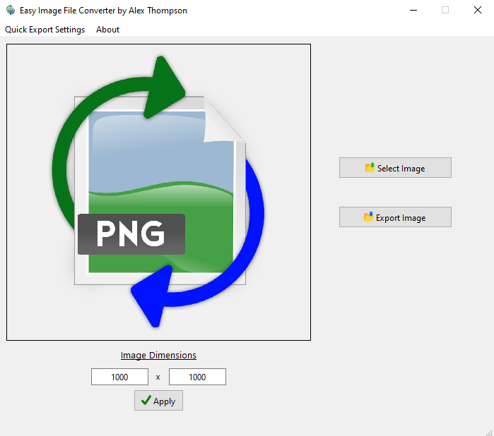
DESCRIPTION
Easy Image File Type Converter
Windows Desktop application
Coded in C++ with QT Framework
Convert one image type to another
Accepted types: PNG, JPG/JPEG, WEBP, TIFF, and BMP
Reliable & Available

Slide 4
DEMO

Slide 5

Future enhancements
More Image File Types
Color Adjuster
User Interface Visual Improvements
Image Link Importing

Slide 6

Challenges to overcome
Time Frame
Installing OpenCV for QT
Displaying Images on the User Interface
Creating Persistent Settings
User Interface Design

Slide 7
THANK YOU

